Slide 1
CMSIS: Cortex Microcontroller Software Interface Standard

Slide 2
Overview
What is CMSIS?
Hardware Abstraction Layer: Layer of software between application program and hardware
Conventions and standards for software interfaces, structure and names
Problem – too many options
Some Cortex-M architectures offer additional instructions
When targeting Cortex-M4, compiler has additional instructions available (e.g. floating point, SIMD) compared with M0+
Many MCU vendors create Cortex-M-based MCUs
Although CPU cores are consistent, peripherals are structured and accessed differently
Many compilers available
Different approaches to implementing features not defined in C/C++ specifications
Many RTOSs available
Different APIs
Benefits
Shortens learning curve on new hardware
Simplifies software development
Simplifies software reuse

Slide 3
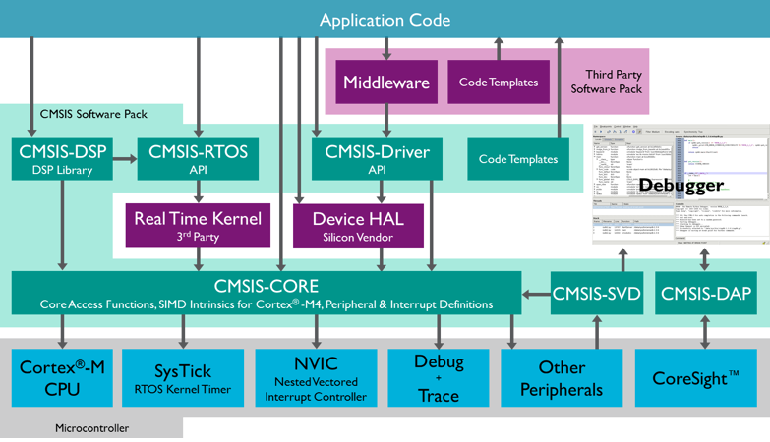
CMSIS Structure
Detailed documentation available through MDK: Help->Open Books Window, then select Tool User’s Guide-> CMSIS Documentation
Notes:
One major benefit of CMSIS is that it standardizes the structure and interfaces between the components shown here, enabling interoperability and simplifying development.

Slide 4
Conventions
General
Compliant with ANSI C and C++
Uses ANSI C <stdint.h> data types
Conforms to MISRA 2004
Naming conventions
CAPITAL names for core registers, peripheral registers, CPU instructions
CamelCase for function and interrupt function names
Namespace_ prefixes to group and isolate functional groups
Documentation
Doxygen-compliant function comments with function overview, detailed description, parameter explanation, return value information
Licensing
Free of charge
Can be used for all Cortex-M-based devices

Slide 5
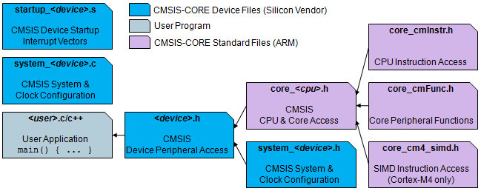
CMSIS-CORE
CMSIS-CORE device files (blue) implement device-specific functionality
User application includes <device.h> to use CMSIS-CORE features
Peripheral access
Interrupts and exceptions
Intrinsic CPU functions
Systick timer
Debug Access for printf-style I/O
Additional features
Standard API for Cortex-M processor core and peripherals
Header file organization and naming conventions
System initialization function skeletons, implemented by MCU vendors
Support for determining system clock frequency

Slide 6
Example: Accessing Hardware Registers in C
Header file MKL25Z4.h
Defines C data structure types to represent MCU hardware registers
/** GPIO - Register Layout Typedef */
typedef struct {
__IO uint32_t PDOR; /**< Port Data Output Register, offset: 0x0 */
__O uint32_t PSOR; /**< Port Set Output Register, offset: 0x4 */
__O uint32_t PCOR; /**< Port Clear Output Register, offset: 0x8 */
__O uint32_t PTOR; /**< Port Toggle Output Register, offset: 0xC */
__I uint32_t PDIR; /**< Port Data Input Register, offset: 0x10 */
__IO uint32_t PDDR; /**< Port Data Direction Register, offset: 0x14 */
} GPIO_Type;

Slide 7
Example: Accessing Hardware Registers in C
Header file MKL25Z4.h
Declares pointers to the registers
/* GPIO - Peripheral instance base addresses */
/** Peripheral PTA base address */
#define PTA_BASE (0x400FF000u)
/** Peripheral PTA base pointer */
#define PTA ((GPIO_Type *)PTA_BASE)
PTA->PDOR = my_data;

Slide 8
Example: Using The Ports
#include <MKL25Z4.h>
#define LED1_POS (1)
#define LED2_POS (2)
#define SW1_POS (5)
#define MASK(x) (1UL << (x))
PTA->PDDR |= MASK(LED1_POS) | MASK(LED2_POS); // set bits to outputs
PTA->PDDR &= ~MASK(SW1_POS); // clear switch bit to input
PTA->PDOR = MASK(LED2_POS); // turn on LED1, turn off LED2
while (1) {
if (PTA->PDIR & MASK(SW1_POS)) { // switch is not pressed, so light LED 2
PTA->PDOR = MASK(LED2_POS);
} else { // switch is pressed, so light LED 1
PTA->PDOR = MASK(LED1_POS);
}
}
Notes:
Here we see how to use CMSIS to access port A for GPIO.

Slide 9
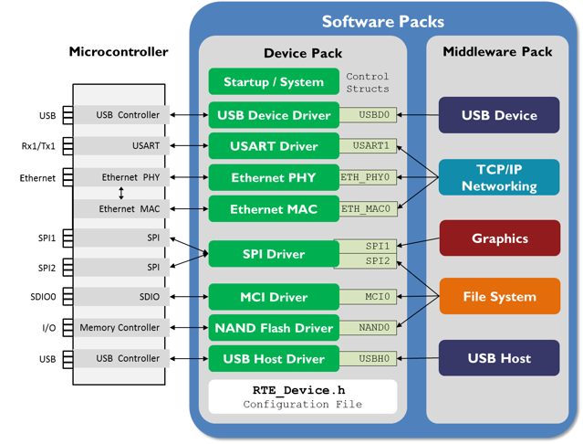
CMSIS-Driver
Software API for peripheral driver interfaces
Generic and RTOS-independent
Covers typical use cases for common peripherals
Example functions for USART
ARM_USART_Control: configure communication parameters
ARM_USART_PowerControl: control USART power mode
ARM_USART_Send: Start to send data in buffer
ARM_USART_Receive: Start to receive data into buffer
ARM_USART_SignalEvent: callback function to notify application when event occurs (e.g. transmission complete)
ARM_USART_GetTxCount: Return number of items which have been sent
etc.

Slide 10
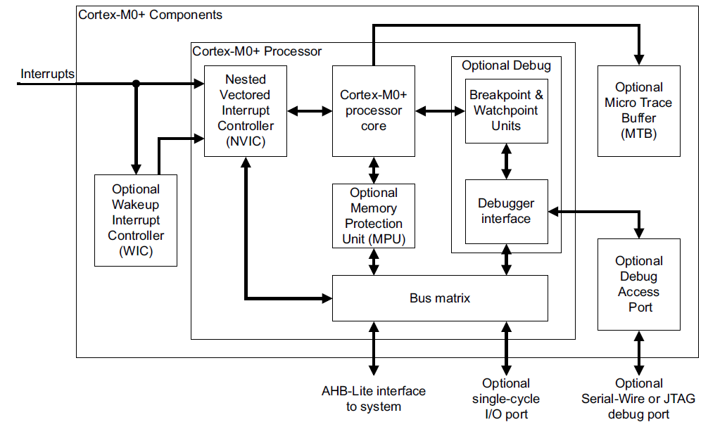

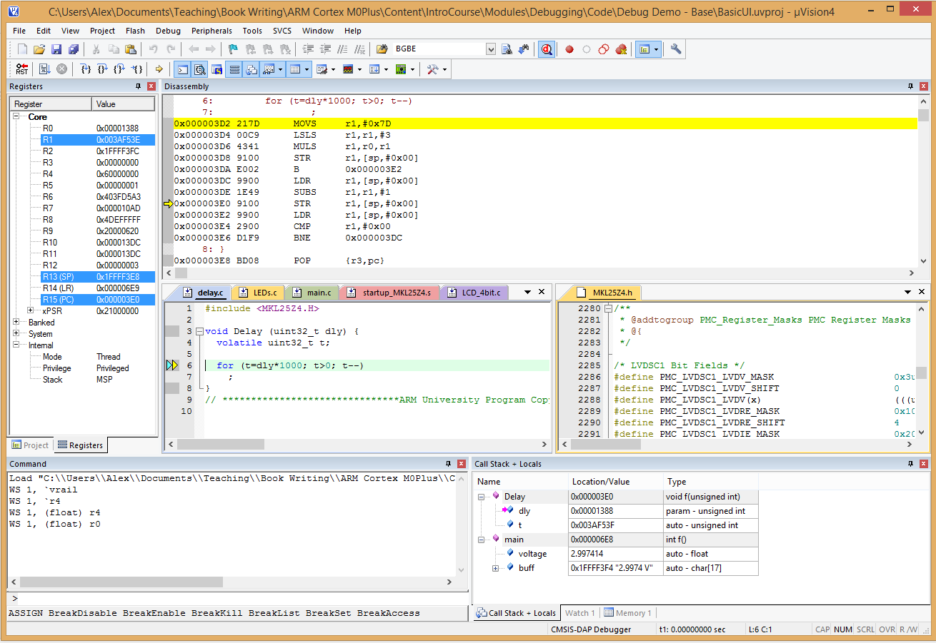
CMSIS-DAP
Cortex-M MCUs have built-in debug support (CoreSight), accessible via Debug Access Port
Use a debug MCU to translate between USB (for PC communications) and target MCU (with JTAG or SW interface)
CMSIS-DAP is standardized firmware for this debug MCU
Debug MCU running CMSIS-DAP firmware
USB
Target MCU

Slide 11
CMSIS-DSP Software Library
Library of fast functions and macros for digital signal processing, other math
Basic math – abs, add, sub, multiply, negate, offset, scale, shift (all support vector operations)
Fast math – sin, cos, sqrt
Complex math
Filters – IIR, FIR, convolution, correlation, FIR LMS, interpolator
Matrix
Transforms – FFT, DCT
Motor control – PID control, Clarke & Park (and inverse) transforms
Statistical – min, max, mean, power, rms, standard deviation, variance
Support – vector fill & copy, convert values
Interpolation – linear, bilinear
Multiple data types supported
32-bit floating point
32-bit integer/fixed point
16-bit integer/fixed point
8-bit integer/fixed point
Different versions optimized for Cortex M versions
M0, M0+, M3, M4
Detailed documentation available through MDK: Help->Open Books Window, then select Tool User’s Guide-> CMSIS Documentation

Slide 12
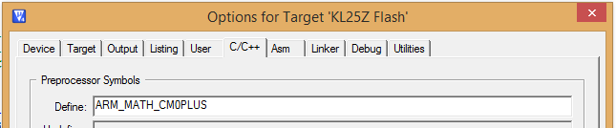
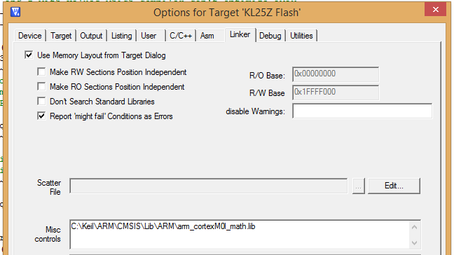
CMSIS-DSP Support for Fixed Point Math
Three fractional fixed point data types supported
q31_t: signed, 1 integer bit, 31 fraction bits
q15_t: signed, 1 integer bit, 15 fraction bits
q7_t: signed, 1 integer bit, 7 fraction bits. Not supported by all functions.
Fractional: range is -1 to +1
To use CMSIS-DSP library
#include <arm_math.h>
C/C++ Tab: Define preprocessor symbol ARM_MATH_CM0PLUS
Linker Tab: Specify ARM math library to use, with location

Slide 13
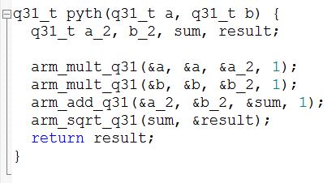
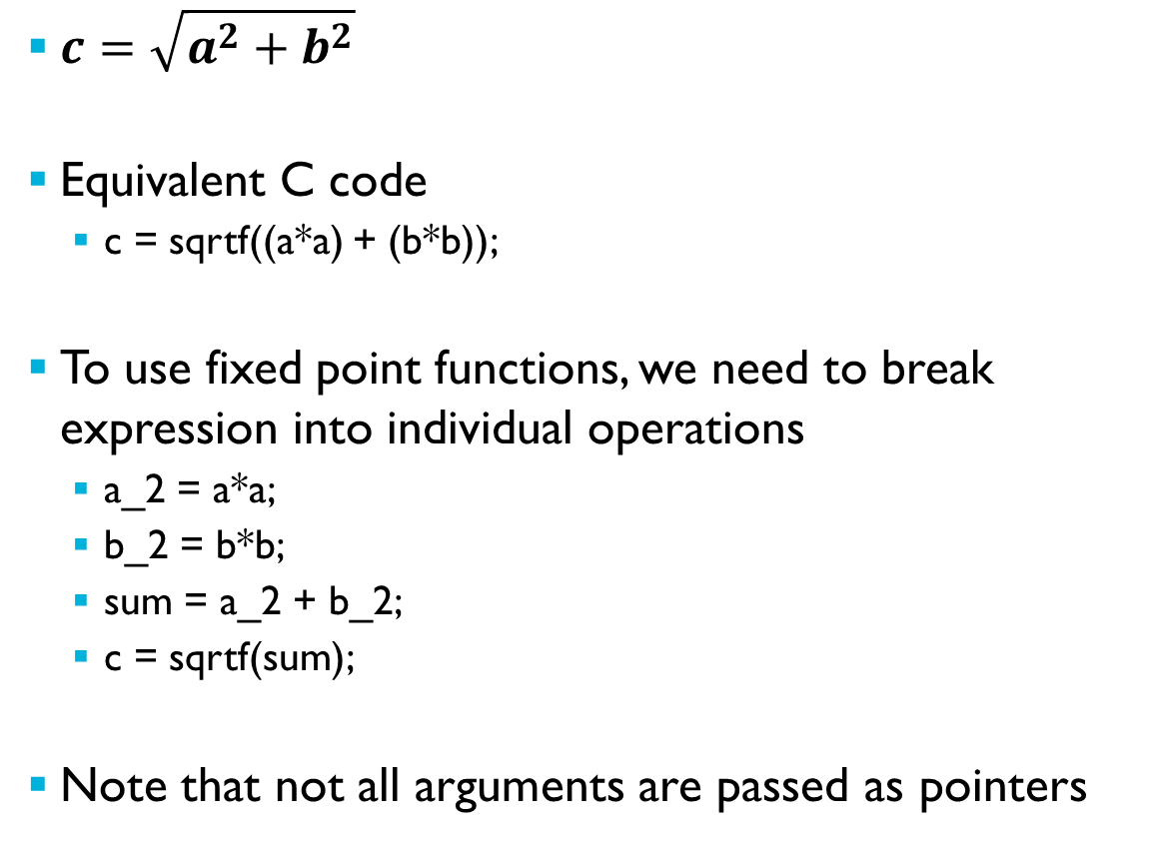
Example Code – Pythagorean Theorem
$c=\sqrt{a^{2}+b^{2}}$
Equivalent C code
c = sqrtf((a*a) + (b*b));
To use fixed point functions, we need to break expression into individual operations
a_2 = a*a;
b_2 = b*b;
sum = a_2 + b_2;
c = sqrtf(sum);
Note that not all arguments are passed as pointers

Slide 14
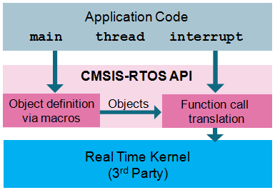
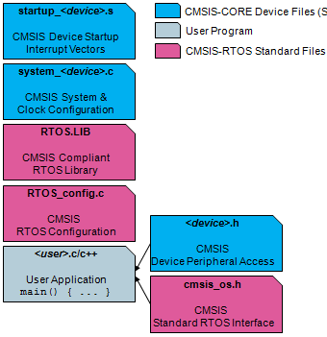
CMSIS-RTOS API
Defines a generic RTOS interface
Provides minimum feature set
May be extended by RTOS vendors
Core Functionality
Kernel information and control
Thread management
Event management: signals, message queues, mail queues
Mutex and semaphore management
Wait functions
Timer management
Memory pool management

Slide 15
Other CMSIS Components
CMSIS-Pack
Delivery mechanism and format for …
Software components
Device parameters
Evaluation board support
CMSIS-SVD
System View Description format
Developed by MCU vendor
Provides formal description of programmer’s view of system (e.g. memory-mapped registers) in MCU
Detailed information similar to reference manual – register names, bit field names, values and functionality
Used to generate CMSIS-compliant device header files

